Slide 1
Object Oriented and Programming
Lab 2
CONTROL STRUCTURES AND LOOPS (Java)

Slide 2
Objectives
Using JoptionPan (Java Swings)
Using one-way selection structure (if)
Using two-way selection structure (if/else)
Using multiple selection structure (switch)
Using ‘for’ repetition structure.
Using ‘while’ repetition structure.
Using ‘do/while’ repetition structure.
Using Strings
Using Arrays

Slide 3
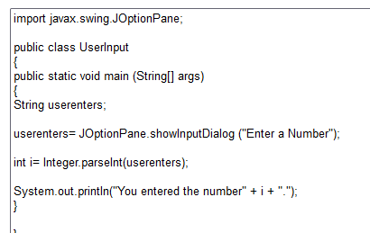
Using JoptionPan

Slide 4
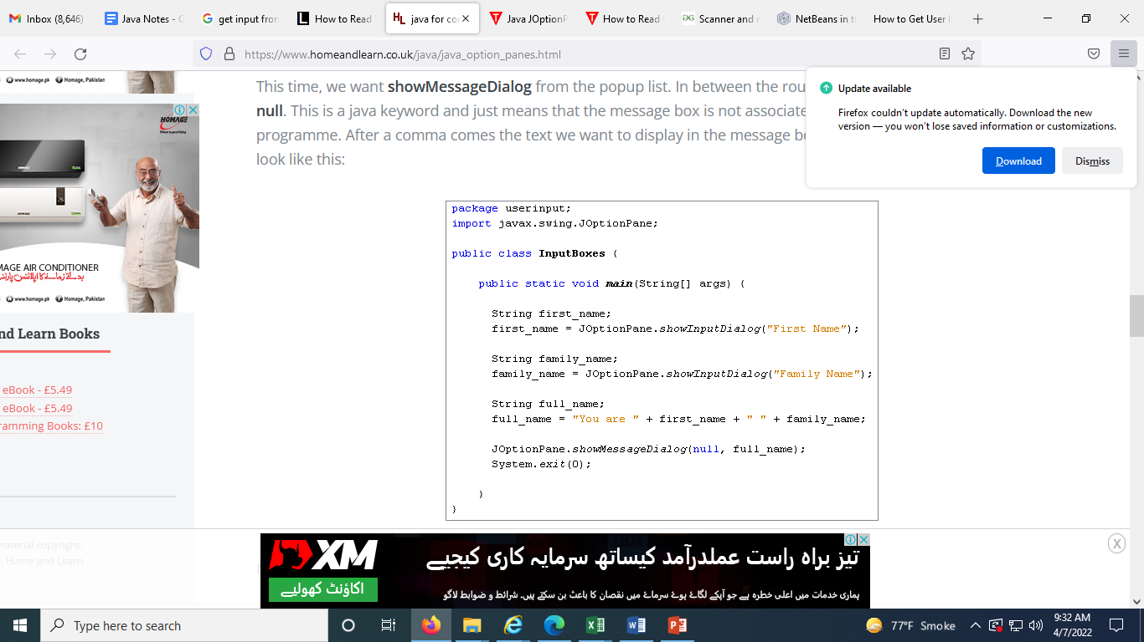
Using JoptionPan ShowMessage

Slide 5
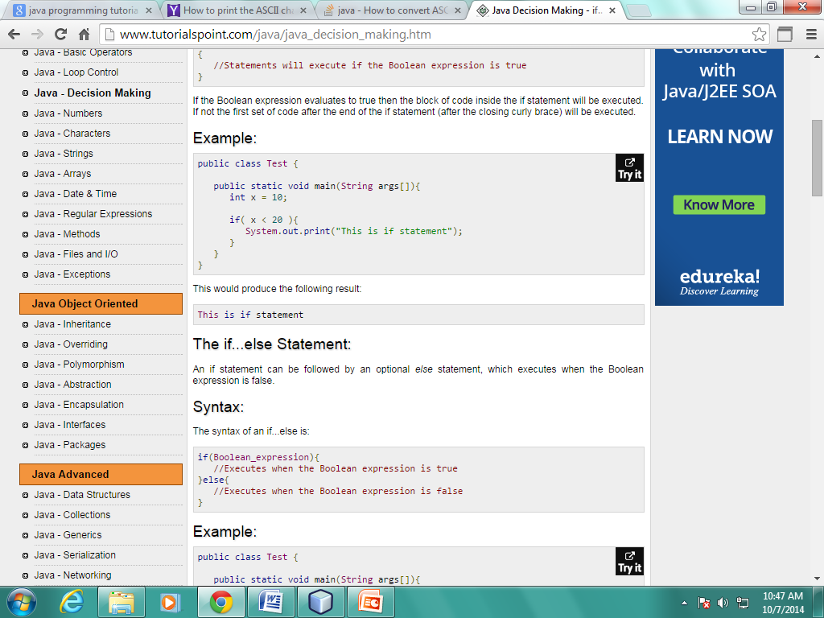
If statement
if(Boolean_expression)
{
//Statements will execute if the Boolean expression is true
}

Slide 6
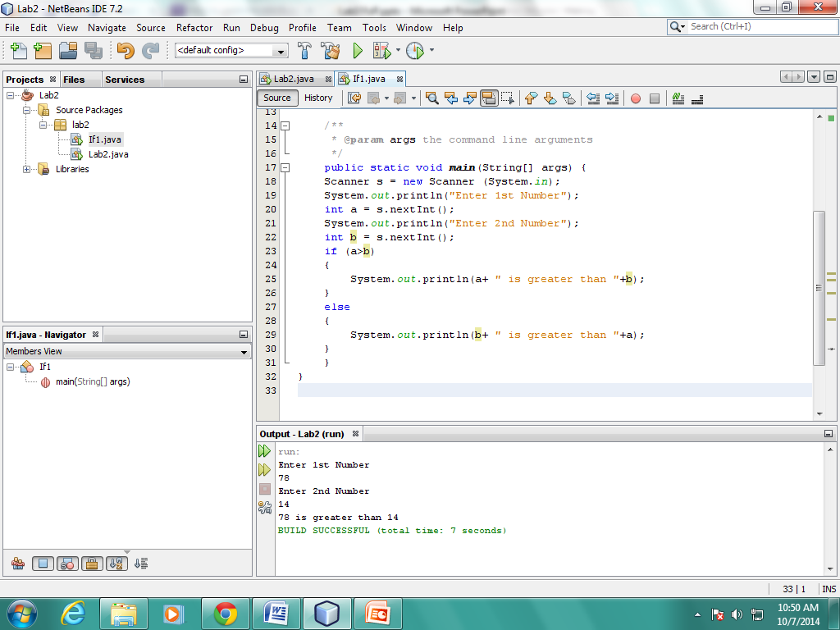
If-Else Statement
if(Boolean_expression)
{
//Executes when the Boolean expression is true }
Else
{
//Executes when the Boolean expression is false
}

Slide 7
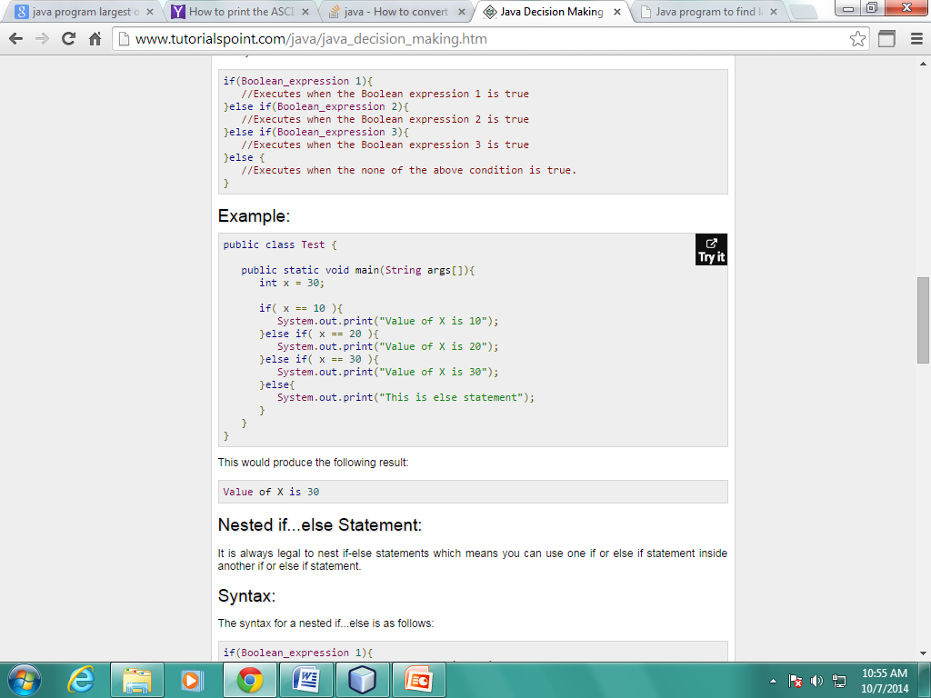
The if...else if...else Statement:
if(Boolean_expression 1)
{ //Executes when the Boolean expression 1 is true }
else if(Boolean_expression 2)
{ //Executes when the Boolean expression 2 is true }
else if(Boolean_expression 3)
{ //Executes when the Boolean expression 3 is true }
else { //Executes when the none of the above condition is true. }

Slide 8
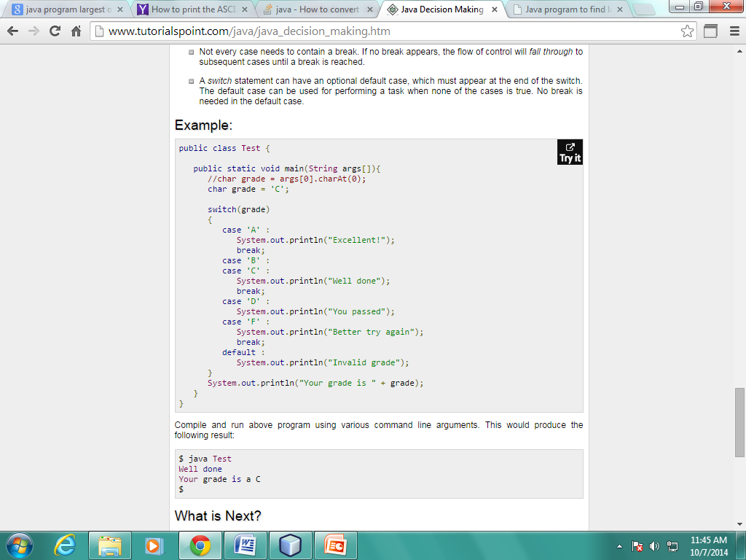
‘switch’ Statement
Switch (expression)
{ case value : //Statements break; //optional
case value : //Statements break; //optional //You can have any number of case statements.
default : //Optional //Statements }

Slide 9
If then Else and Swtich
Write a Java program that reads a floating-point number and prints "zero" if the number is zero. Otherwise, print "positive" or "negative".

Slide 10
Write a Java program to display the pattern like a right angle triangle with a number.
Test Data
Input number of rows : 10
Expected Output :
1
12
123
1234
12345
123456
1234567
12345678
123456789
12345678910

Slide 11
Strings
Strings, which are widely used in Java programming, are a sequence of characters. In the Java programming language, strings are objects. The Java platform provides the String class to create and manipulate strings.

Slide 12
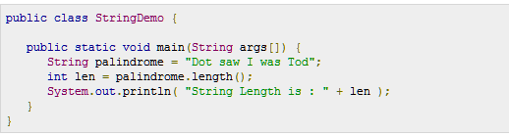
Method | Description | Return Type
charAt() | Returns the character at the specified index (position) | char
concat() | Appends a string to the end of another string | String
length() | Returns the length of a specified string | int
substring() | Returns a new string which is the substring of a specified string | String
toLowerCase() | Converts a string to lower case letters | String
toUpperCase() | Converts a string to upper case letters | String

Slide 13
Arrays
Java provides a data structure, the array, which stores a fixed-size sequential collection of elements of the same type. An array is used to store a collection of data, but it is often more useful to think of an array as a collection of variables of the same type.

Slide 14
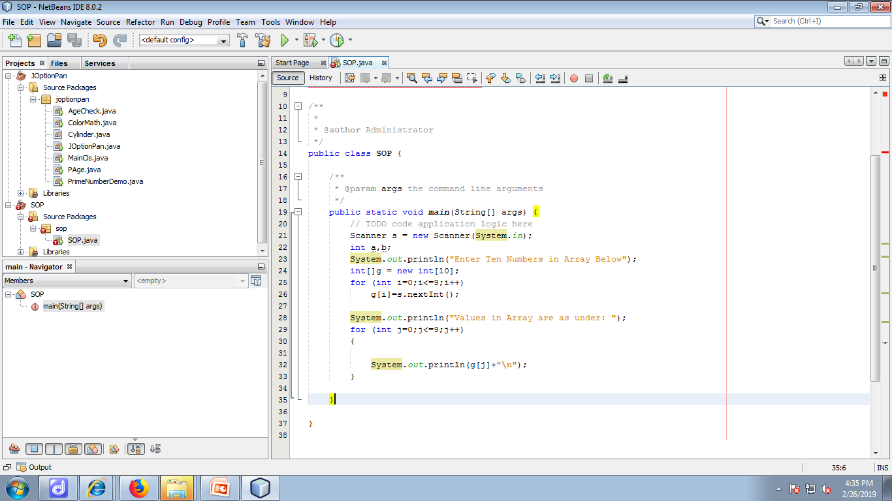

Slide 15
public static void main(String[] args)
{ int ct=0,n=0,i=1,j=1;
while(n<10) { //outer loop
j=1; ct=0;
while(j<=i) {
if(i%j==0)
ct++;
j++; } // Inner Loop
if(ct==2) {
System.out.printf("%d ",i);
n++;
} // if
i++;
}
}

